Slide 1

The world of software : security
Capstone Experience in Digital Forensics Cybersecurity
2020 Fall Term (1) JOHN JAY NYC
Professor Jennifer Holst

Slide 2
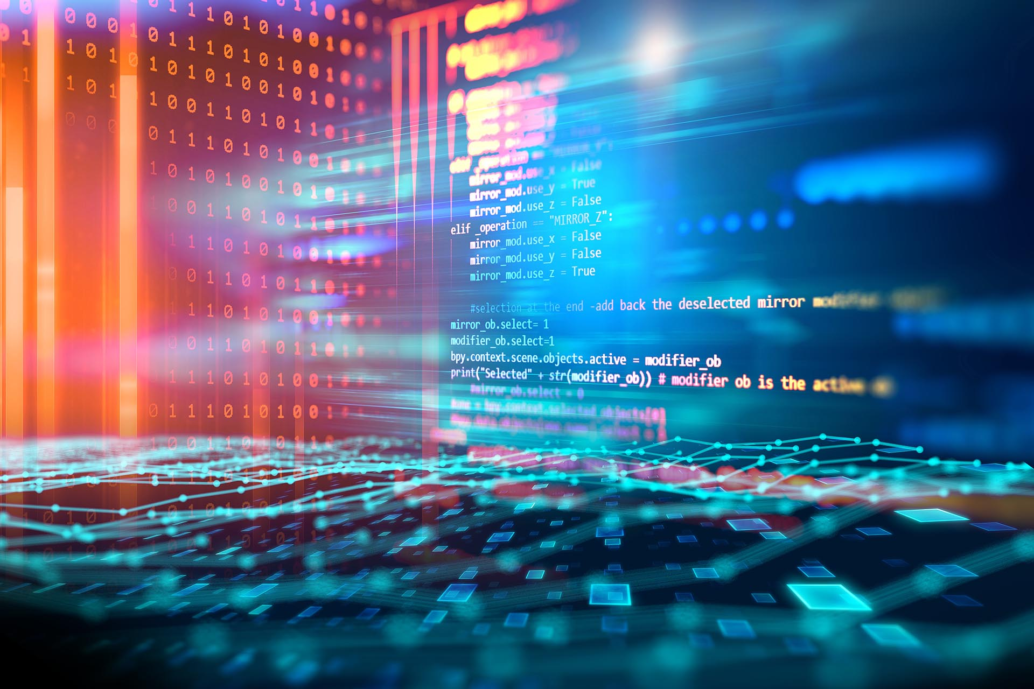
What is a software ?
Software is a collection of data or computer instructions that tell the computer how to work. This is in contrast to physical hardware, from which the system is built and actually performs the work. In computer science and software engineering, computer software is all information processed by computer systems, programs and data. Computer software includes computer programs, libraries and related non-executable data, such as online documentation or digital media. Computer hardware and software require each other and neither can be realistically used on its own.
The majority of software is written in high-level programming languages. They are easier and more efficient for programmers because they are closer to natural languages than machine languages.[1] High-level languages are translated into machine language using a compiler or an interpreter or a combination of the two.

Slide 3
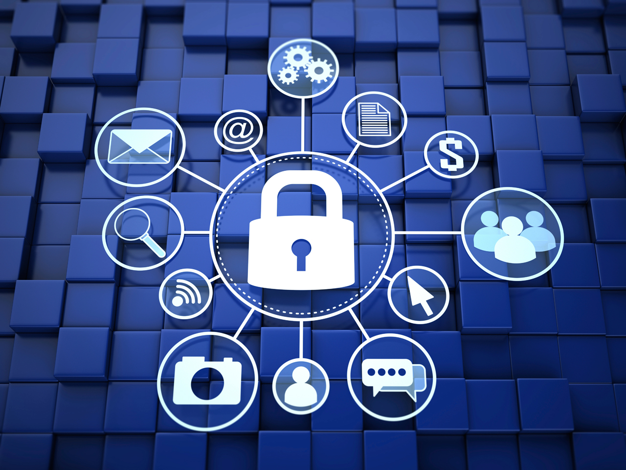
What is Software Security?
Software security is the idea of engineering software so that it continues to function correctly under malicious attack.
The software security field is a relatively new one. The first books and academic classes on the topic appeared in 2001, demonstrating how recently developers, architects and computer scientists have started systematically studying how to build secure software. The field’s recent appearance is one reason why best practices are neither widely adopted nor obvious.
Software security best practices leverage good software engineering practice and involve thinking about security early in the software development lifecycle.

Slide 4
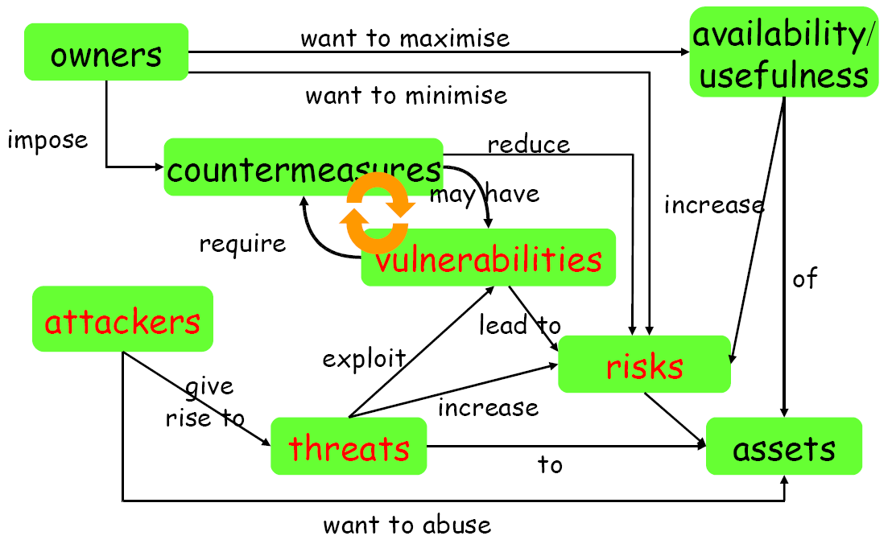
What is Software Security?
SECURITY CONCEPTS
Software security is the idea of engineering software so that it continues to function correctly under malicious attack.
The software security field is a relatively new one. The first books and academic classes on the topic appeared in 2001, demonstrating how recently developers, architects and computer scientists have started systematically studying how to build secure software. The field’s recent appearance is one reason why best practices are neither widely adopted nor obvious.
Software security best practices leverage good software engineering practice and involve thinking about security early in the software development lifecycle.

Slide 5

Software Development Life Cycle

Slide 6
What is SDLC (Software Development Life Cycle)?
The Software Development Life Cycle (SDLC) is a structured process that enables the production of high-quality, low-cost software, in the shortest possible production time.
The goal of the SDLC is to produce superior software that meets and exceeds all customer expectations and demands.
The SDLC defines and outlines a detailed plan with stages, or phases, that each encompass their own process and deliverables.
Adherence to the SDLC enhances development speed and minimizes project risks and costs associated with alternative methods of production
How was the SDLC created?
In the 1950s and 1960s, computer science progressed rapidly. This swift evolution sparked the beginnings of a production framework that eventually grew into the SDLC we know today.
Prior to the 1950s, computing was not elaborate enough to necessitate a detailed approach like the SDLC. As the complexity and scale of programming grew, the concept of structured programming emerged.
Over time, structured programming demanded more tactical development models, thus sparking the beginnings of the SDLC (ii).
Why is the SDLC important?
Here, are some prime reasons why SDLC is important for developing a software system:
It provides a standardized framework that defines activities and deliverables
It aids in project planning, estimating, and scheduling
It makes project tracking and control easier
It decreases project management expenses and the overall cost of production

Slide 7
SDLC Phases
Planning phase
The planning phase encompasses all aspects of project and product management. This typically includes resource allocation, capacity planning, project scheduling, cost estimation, and provisioning
During the planning phase, the development team collects input from stakeholders involved in the project; customers, sales, internal and external experts, and developers. This input is synthesized into a detailed definition of the requirements for creating the desired software.
Expectations are clearly defined during this stage as well; the team determines not only what is desired in the software, but also what is NOT. The tangible deliverables produced from this phase include project plans, estimated costs, projected schedules, and procurement needs.
Coding phase
The coding phase includes system design in an integrated development environment. It also includes static code analysis and code review for multiple types of devices.
Building Phase
The building phase takes the code requirements determined earlier and uses those to begin actually building the software.
Testing Phase
Once the software is complete, and it is deployed in the testing environment. The testing team starts testing the functionality of the entire system.
During this phase, QA and testing team may find some bugs/defects which they communicate to developers.
This process continues until the software is bug-free, stable, and working according to the business needs of that system.

Slide 8
SDLC Phases
Release Phase
The release phase involves the team packaging, managing and deploying releases across different environments.
Deploy Phase
In the deployment phase, the software is officially released into the production environment.
Operate Phase
The operate phase entails the use of the software in the production environment.
Monitor Phase
In the monitor phase, various elements of the software are monitored. These could include the overall system performance, user experience, new security vulnerabilities, an analysis of bugs or errors in the system.

Slide 9

Software vulnerabilities
What Do We Mean By Software Vulnerability?
A software vulnerability is a glitch, flaw, or weakness present in the software or in an OS (Operating System). The severity of software vulnerabilities advances at an exponential rate. Of course, all systems include vulnerabilities. The thing is whether or not they’re exploited to cause damage.
Software vulnerabilities are explained by three ideal factors. These are:
Existence – The existence of a vulnerability in the software.
Access – The possibility that hackers gain access to the vulnerability.
Exploit – The capability of the hacker to take advantage of that vulnerability via tools or with certain techniques.

Slide 10

Typical Software Security Vulnerabilities

Slide 11
Sources of Software Vulnerabilities
Bugs in the application or its infrastructure
i.e. doesn't do what it should do
E.g., access flag can be modified by user input
Inappropriate features in the infrastructure
i.e. does something that it shouldn't do functionality winning over security
E.g., a search function that can display other users info
Inappropriate use of features provided by the infrastructure
Main causes:
complexity of these features functionality winning over security, again ignorance of developers

Slide 12
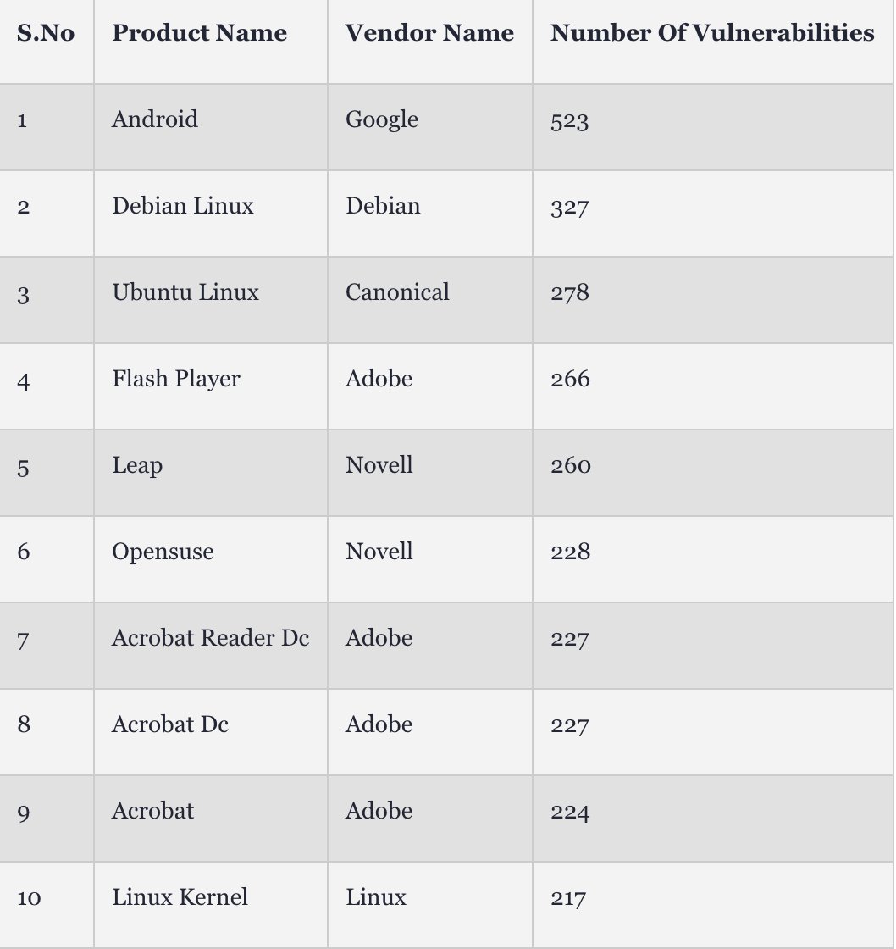
More and more organizations today are seeing vulnerabilities in their code exploited. For instance, here we presented the table that shows the top 10 software products with the most security flaws in 2016

Slide 13

Countermeasures and More Vulnerabilities
Countermeasures can lead to new vulnerabilities
E.g., if we only allow three incorrect logins, as a countermeasure to brute-force attacks (account be frozen), which new vulnerability do we introduce?
DENIAL OF SERVICE ATTACK
If a countermeasure relies on new software, bugs in this new software may mean that it is ineffective, or worse still, that it introduces more weaknesses
E.g., Witty worm appeared in Mar 2004 exploited ISS security software

Slide 14
Countermeasures
What are the methods and technologies, available to us if we want to provide security?
security in the software development lifecycle
engineering & design principles
security technologies

Slide 15
Countermeasures
Cryptography
for threats related to insecure communication and storage
Covered in other courses
Access control
for threats related to misbehaving users
E.g., role-based access control
Language-based security
for threats related to misbehaving programs
typing, memory-safety
sandboxing
E.g., Java, .NET/C#
These technologies may be provided by the infrastructure/platform an application builds on,
networking infrastructure
which may e.g. use SSL
operating system or database system
providing e.g. access control
programming platform
for instance Java or .NET sandboxing
SPOOFING IDENTITY
AUTHENTICATION, PROTECT KEYS & PASSWORDS, ...
TAMPERING WITH DATA
ACCESS CONTROL, HASHES, DIGITAL SIGNATURES, MACS (MESSAGE AUTHENTICATION CODES), WRITE-ONCE STORAGE...
REPUDIATION
LOGGING, AUDIT TRAILS, DIGITAL SIGNATURES, ...
INFORMATION DISCLOSURE
ACCESS CONTROL, ENCRYPTION, NOT STORING SECRETS, ...
DENIAL OF SERVICE
GRACEFUL DEGRADATION, FILTERING, INCREASE SERVER RESOURCES
ELEVATION OF PRIVILEGE
ACCESS CONTROL, SANDBOXING, ...

Slide 16

Source: Gary McGraw, Software security, Security & Privacy Magazine, IEEE, Vol 2, No. 2, pp. 80-83, 2004.
GABRIEL AVNER, JANUARY 31, 2019, Software Vulnerability 101 : https://resources.whitesourcesoftware.com/blog-whitesource/software-vulnerability#:~:text=At%20its%20core%2C%20a%20software,forgetting%20to%20close%20a%20parenthesis.
Somesh Mohanty, Mar. 08, 18 · Security Zone · Analysis : https://dzone.com/articles/5-important-software-vulnerability-and-attacks-tha#:~:text=A%20software%20vulnerability%20is%20a,re%20exploited%20to%20cause%20damage.
https://www.synopsys.com/glossary/what-is-sdlc.html

